Slide 1
How to Access QLD state Library
12 Psychology

Slide 2
QLD state library
Full text copies of peer reviewed journal articles can be accessed through the QLD State Library using the ProQuest data base.
To access QLD State Library resources you will need to become a member.
Membership is available to all QLD residents and is free.
https://www.slq.qld.gov.au/services/membership

Slide 3

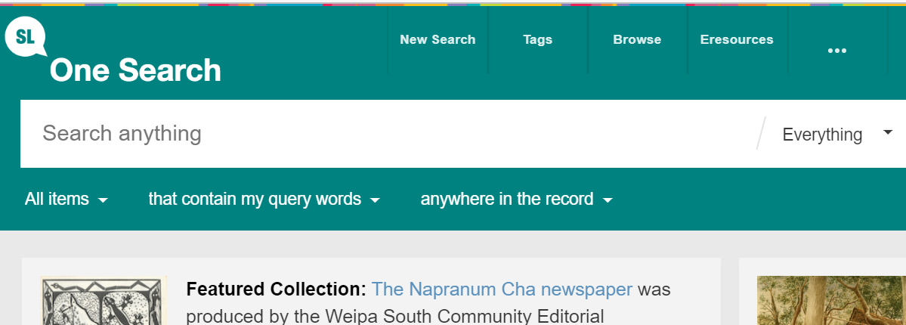
Log in to the catalogue
https://www.slq.qld.gov.au/
Click on eresources

Slide 4
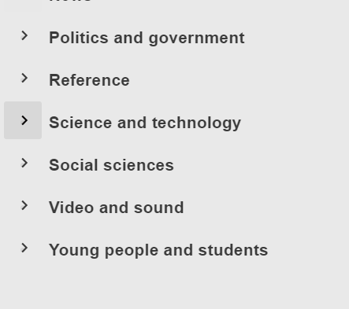
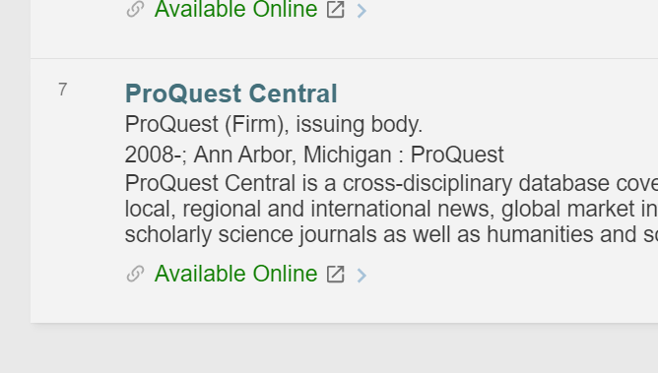
Select Science and Technology
from Databases by Category
Scroll down and select ProQuest Central.
Click on Available Online

Slide 5
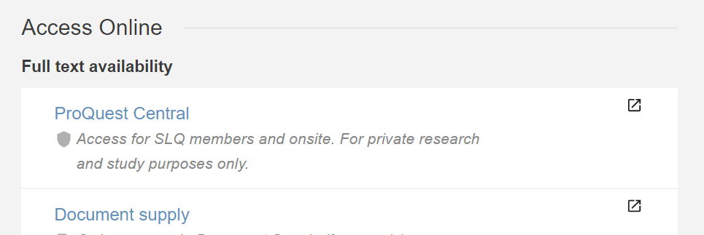
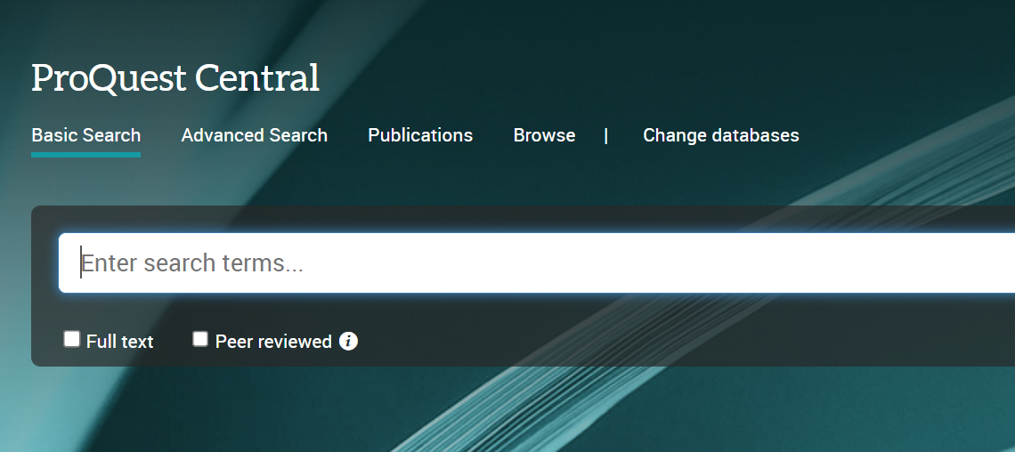
Select ProQuest Central
Select Advanced Search

Slide 6
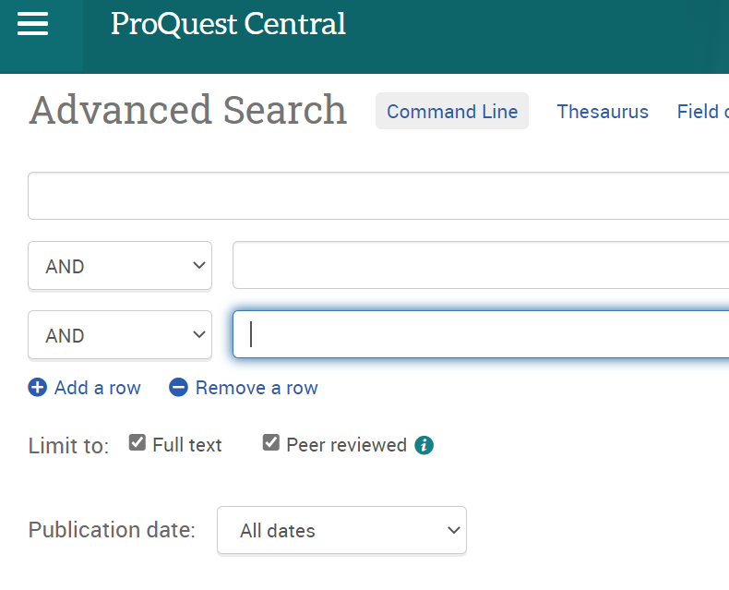
Enter your search terms
You can enter a full journal article title
Tick full text
Tick Peer Reviewed

